Slide 1
Relating Graph Thickness to Planar Layers and Bend Complexity
Stephane Durocher Debajyoti Mondal
Department of Computer Science
University of Manitoba, Canada
ICALP 2016
July 12, 2016
Notes:
Thank you session chair, I am going to present our paper entitled Drawing Plane Triangulations with Few Segments.
This is a joint work with my supervisor dr. stephane durocher.
And we are from University of Manitoba.

Slide 2
Relating Graph Thickness to Planar Layers and Bend Complexity
Thickness:
The smallest integer k such that G can be decomposed into k planar graphs.
ICALP 2016
July 12, 2016

Slide 3
Relating Graph Thickness to Planar Layers and Bend Complexity
Thickness:
The smallest integer k such that G can be decomposed into k planar graphs.
K₉ is a thickness-3 graph
http://www.sis.uta.fi/cs/reports/dsarja/D-2009-3.pdf
ICALP 2016
July 12, 2016

Slide 4
Layer Complexity and Bend Complexity
Layer Complexity of a Drawing D :
The smallest number r such that D can be decomposed into r planar drawings.
Layer complexity = 3

Slide 5
Layer Complexity and Bend Complexity
Layer Complexity of a Drawing D :
The smallest number r such that D can be decomposed into r planar drawings.
Bend Complexity of a Drawing D → the number of bends per edge.
Layer complexity = 3, Bend complexity = 2

Slide 6
Graph Thickness, Layer Complexity and Bend Complexity
ICALP 2016
July 12, 2016

Slide 7
Graph Thickness, Layer Complexity and Bend Complexity
[Fáry, 1948] (planar graphs) Thickness-1 graphs → 1 layer, bend complexity 0
[Erten and Kobourov, 2005] Thickness-2 graphs → 2 layers, bend complexity 2
[Pach and Wenger, 2001] Thickness-t graphs → t layers, bend complexity O(n)
[Badent et al., 2008 & Gordon, 2012] Thickness-t graphs → t layers, bend complexity 3n+O(1)
ICALP 2016
July 12, 2016

Slide 8
Graph Thickness, Layer Complexity and Bend Complexity
[Fáry, 1948] (planar graphs) Thickness-1 graphs → 1 layer, bend complexity 0
[Erten and Kobourov, 2005] Thickness-2 graphs → 2 layers, bend complexity 2
[Pach and Wenger, 2001] Thickness-t graphs → t layers, bend complexity O(n)
[Badent et al., 2008 & Gordon, 2012] Thickness-t graphs → t layers, bend complexity 3n+O(1)
Questions
Can we draw thickness-t graphs in t layers with o(n) bend complexity?
Can we improve the 3n+O(1) bound?
ICALP 2016
July 12, 2016

Slide 9
Graph Thickness, Layer Complexity and Bend Complexity
[Fáry, 1948] (planar graphs) Thickness-1 graphs → 1 layer, bend complexity 0
[Erten and Kobourov, 2005] Thickness-2 graphs → 2 layers, bend complexity 2
[Pach and Wenger, 2001] Thickness-t graphs → t layers, bend complexity O(n)
[Badent et al., 2008 & Gordon, 2012] Thickness-t graphs → t layers, bend complexity 3n+O(1)
Questions
Can we draw thickness-t graphs in t layers with o(n) bend complexity?
This Presentation → Yes, for any fixed t
Can we improve the 3n+O(1) bound?
This Presentation → 2.5n + O(1)
ICALP 2016
July 12, 2016

Slide 10
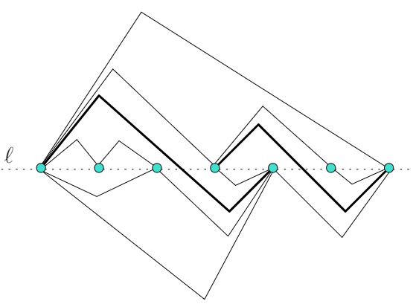
[Erten and Kobourov, 2005]
Thickness-2 graphs, 2 layers, bend complexity 2
Every planar graph has a
monotone topological book embedding.
ICALP 2016
July 12, 2016

Slide 11
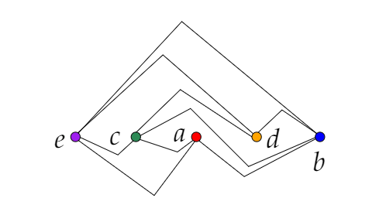
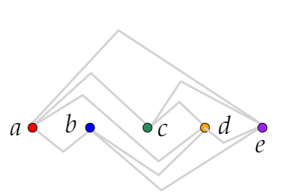
[Erten and Kobourov, 2005]
Thickness-2 graphs, 2 layers, bend complexity 2
Take the monotone topological book embeddings of the planar layers.
ICALP 2016
July 12, 2016

Slide 12
[Erten and Kobourov, 2005]
Thickness-2 graphs, 2 layers, bend complexity 2
Take the monotone topological book embeddings of the planar layers.
Create corresponding Hamiltonian paths, insert dummy vertices at the crossing.
e
c
a
x₁
d
b
a
b
c
x₁
d
e
ICALP 2016
July 12, 2016

Slide 13
[Erten and Kobourov, 2005]
Thickness-2 graphs, 2 layers, bend complexity 2
Take the monotone topological book embeddings of the planar layers.
Create corresponding Hamiltonian paths, insert dummy vertices at the crossing.
Create vertex positions. Draw the edges.
e
e
c
a
x₁
d
b
d
c
x₁
b
a
a
b
c
x₁
d
e
e
c
a
x₁
d
b
ICALP 2016
July 12, 2016

Slide 14
[Erten and Kobourov, 2005]
Thickness-2 graphs, 2 layers, bend complexity 2
Take the monotone topological book embeddings of the planar layers.
Create corresponding Hamiltonian paths, insert dummy vertices at the crossing.
Create vertex positions. Draw the edges.
e
e
c
a
x₁
d
b
d
c
x₁
b
a
a
b
c
x₁
d
e
e
c
a
x₁
d
b
ICALP 2016
July 12, 2016

Slide 15
[Erten and Kobourov, 2005]
Thickness-2 graphs, 2 layers, bend complexity 2
Take the monotone topological book embeddings of the planar layers.
Create corresponding Hamiltonian paths, insert dummy vertices at the crossing.
Create vertex positions. Draw the edges.
e
e
c
a
x₁
d
b
d
c
x₁
b
a
a
b
c
x₁
d
e
e
c
a
x₁
d
b
ICALP 2016
July 12, 2016

Slide 16
[Erten and Kobourov, 2005]
Thickness-2 graphs, 2 layers, bend complexity 2
Take the monotone topological book embeddings of the planar layers.
Create corresponding Hamiltonian paths, insert dummy vertices at the crossing.
Create vertex positions. Draw the edges.
e
e
c
a
x₁
d
b
d
c
x₁
b
a
a
b
c
x₁
d
e
e
c
a
x₁
d
b
ICALP 2016
July 12, 2016

Slide 17
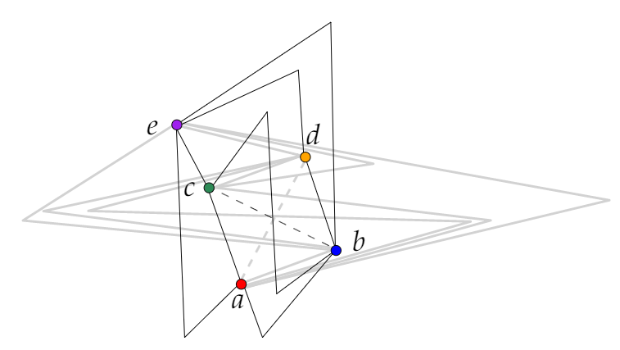
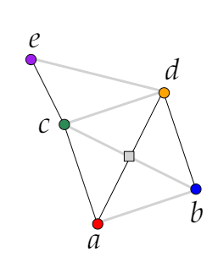
[Erten and Kobourov, 2005]
Thickness-2 graphs, 2 layers, bend complexity 2
Take the monotone topological book embeddings of the planar layers.
Create corresponding Hamiltonian paths, insert dummy vertices at the crossing.
Create vertex positions. Draw the edges.
ICALP 2016
July 12, 2016

Slide 18
[Erten and Kobourov, 2005]
Thickness-2 graphs, 2 layers, bend complexity 2
Take the monotone topological book embeddings of the planar layers.
Create corresponding Hamiltonian paths, insert dummy vertices at the crossing.
Create vertex positions. Draw the edges.
No extension to
three or more paths was known!
ICALP 2016
July 12, 2016

Slide 19
Thickness-4 graphs, 4 layers, bend complexity O(√n)
ICALP 2016
July 12, 2016

Slide 20
Thickness-4 graphs, 4 layers, bend complexity O(√n)
Let S be a set of n labeled points ordered by increasing x-coordinates.
Partition S into r ordered subsets such that each subset contains a set of consecutive points from S, and each of size O(k).
A labelling of S is called smart if the indices in each subset is either increasing or decreasing.
ICALP 2016
July 12, 2016

Slide 21
Thickness-4 graphs, 4 layers, bend complexity O(√n)
Let S be a set of n labeled points ordered by increasing x-coordinates.
Partition S into r ordered subsets such that each subset contains a set of consecutive points from S, and each of size O(k).
A labelling of S is called smart if the indices in each subset is either increasing or decreasing.
r-groups
O(k)
ICALP 2016
July 12, 2016

Slide 22
Thickness-4 graphs, 4 layers, bend complexity O(√n)
Let S be a set of n labeled points ordered by increasing x-coordinates.
Partition S into r ordered subsets such that each subset contains a set of consecutive points from S, and each of size O(k).
A labelling of S is called smart if the indices in each subset is either increasing or decreasing.
r-groups
2
5
8
11
15
7
6
1
16
14
12
9
3
4
10
13
O(k)
ICALP 2016
July 12, 2016

Slide 23
Thickness-4 graphs, 4 layers, bend complexity O(√n)
Let S be a set of n labeled points ordered by increasing x-coordinates.
Partition S into r ordered subsets such that each subset contains a set of consecutive points from S, and each of size O(k).
A labelling of S is called smart if the indices in each subset is either increasing or decreasing.
r-groups
2
5
8
11
15
7
6
1
16
14
12
9
3
4
10
13
O(k)
The corresponding path can be drawn with O(r) bend complexity
ICALP 2016
July 12, 2016

Slide 24
Thickness-4 graphs, 4 layers, bend complexity O(√n)
Let S be a set of n labeled points ordered by increasing x-coordinates.
Partition S into r ordered subsets such that each subset contains a set of consecutive points from S, and each of size O(k).
A labelling of S is called smart if the indices in each subset is either increasing or decreasing.
2
5
8
11
15
7
6
1
16
14
12
9
3
4
10
13
The corresponding path can be drawn with O(r) bend complexity
ICALP 2016
July 12, 2016

Slide 25
Thickness-4 graphs, 4 layers, bend complexity O(√n)
Let S be a set of n labeled points ordered by increasing x-coordinates.
Partition S into r ordered subsets such that each subset contains a set of consecutive points from S, and each of size O(k).
A labelling of S is called smart if the indices in each subset is either increasing or decreasing.
2
5
8
11
15
7
6
1
16
14
12
9
3
4
10
13
The corresponding path can be drawn with O(r) bend complexity
ICALP 2016
July 12, 2016

Slide 26
Thickness-4 graphs, 4 layers, bend complexity O(√n)
Let S be a set of n labeled points ordered by increasing x-coordinates.
Partition S into r ordered subsets such that each subset contains a set of consecutive points from S, and each of size O(k).
A labelling of S is called smart if the indices in each subset is either increasing or decreasing.
2
5
8
11
15
7
6
1
16
14
12
9
3
4
10
13
The corresponding path can be drawn with O(r) bend complexity
ICALP 2016
July 12, 2016

Slide 27
Thickness-4 graphs, 4 layers, bend complexity O(√n)
Let S be a set of n labeled points ordered by increasing x-coordinates.
Partition S into r ordered subsets such that each subset contains a set of consecutive points from S, and each of size O(k).
A labelling of S is called smart if the indices in each subset is either increasing or decreasing.
2
5
8
11
15
7
6
1
16
14
12
9
3
4
10
13
The corresponding path can be drawn with O(r) bend complexity
ICALP 2016
July 12, 2016

Slide 28
Thickness-4 graphs, 4 layers, bend complexity O(√n)
Let S be a set of n labeled points ordered by increasing x-coordinates.
Partition S into r ordered subsets such that each subset contains a set of consecutive points from S, and each of size O(k).
A labelling of S is called smart if the indices in each subset is either increasing or decreasing.
6
10
5
13
2
11
7
1
16
12
3
4
8
14
15
9
The corresponding path can be drawn with O(r) bend complexity
ICALP 2016
July 12, 2016

Slide 29
Thickness-4 graphs, 4 layers, bend complexity O(√n)
[Erdӧs-Szekeres, 1935]
Every point set of n points can be partitioned into O(√n) monotone chains.
ICALP 2016
July 12, 2016

Slide 30
Thickness-4 graphs, 4 layers, bend complexity O(√n)
Increasing or decreasing
along both x-axis and y-axis
[Erdӧs-Szekeres, 1935]
Every point set of n points can be partitioned into O(√n) monotone chains.
ICALP 2016
July 12, 2016

Slide 31
Thickness-4 graphs, 4 layers, bend complexity O(√n)
P₁
P₂
P₃
P₄
ICALP 2016
July 12, 2016

Slide 32
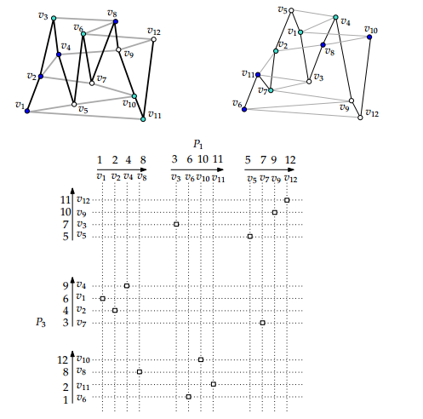
Thickness-4 graphs, 4 layers, bend complexity O(√n)
P₁
P₂
P₃
P₄
ICALP 2016
July 12, 2016

Slide 33
Thickness-4 graphs, 4 layers, bend complexity O(√n)
P₁
P₂
P₃
P₄
ICALP 2016
July 12, 2016

Slide 34
Thickness-4 graphs, 4 layers, bend complexity O(√n)
P₁
P₂
P₃
P₄
ICALP 2016
July 12, 2016

Slide 35
Thickness-4 graphs, 4 layers, bend complexity O(√n)
P₁
P₂
P₃
P₄
ICALP 2016
July 12, 2016

Slide 36
Thickness-4 graphs, 4 layers, bend complexity O(√n)
P₁
P₂
P₃
P₄
ICALP 2016
July 12, 2016

Slide 37
Thickness-4 graphs, 4 layers, bend complexity O(√n)
P₁
P₂
P₃
P₄
ICALP 2016
July 12, 2016

Slide 38
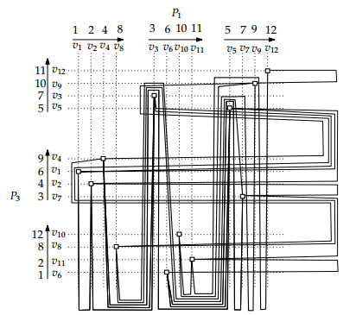
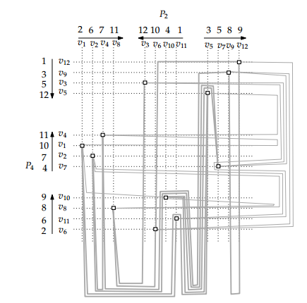
Thickness-4 graphs, 4 layers, bend complexity O(√n)
P₁
P₂
P₃
P₄
ICALP 2016
July 12, 2016

Slide 39
Thickness-t, t layers, Bend Complexity ?
ICALP 2016
July 12, 2016

Slide 40
Thickness-t, t layers, Bend Complexity O(2^{t/2} n^{1-(1/β)})
(15, 10, 9, …) (6, 1, 10,…) (2, 8, 11,…) (3, 14, 5, …) (4, 2, 1,…) (1,13,12)
…
(15, 10, 9, …) (6, 1, 10,…), (2, 8, 11,…) (1,13,12)
(3, 14, 5, …) (4, 2, 1,…)
…
…
(15, 10, 9, …) (2, 8, 11,…)
(6, 1, 10,…) (1,13,12)
…
…
Generalization of [Erdӧs-Szekeres, 1935]
in higher dimension (Monotone in each dimension).
Every n-vertex graph G of thickness t>2 graph admits a drawing on t layers with bend complexity O(2^{t/2} n^{1-(1/β)}), where β = ⌈(t-2)/2⌉.
ICALP 2016
July 12, 2016

Slide 41
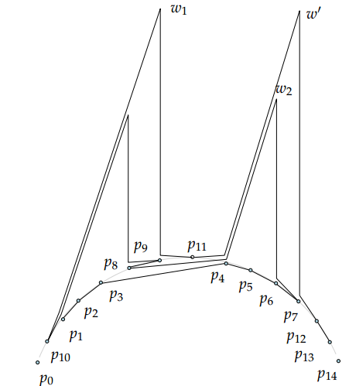
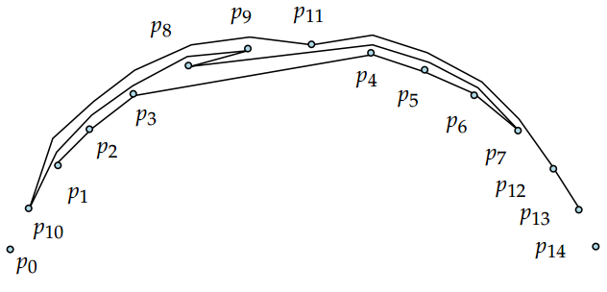
Thickness-t, t layers, Bend Complexity 2.5n + O(1)
Bend intervals are nested like balanced parenthesis.
Stretch out the bend intervals!
ICALP 2016
July 12, 2016

Slide 42
Future Research
Thickness-2: Can we draw every thickness-2 graph on 2 planar layers with bend complexity 1?
Thickness-t: Can we draw every thickness-t graph, where t > 2, on t planar layers with bend complexity o(√n)? Is there an Ω(√n) lower bound on the bend complexity?
Trade-offs: How the bend complexity varies if we allow more than t planar layers to draw a thickness-t graph?
ICALP 2016
July 12, 2016

Slide 43
Thank You..

Slide 44
Appendix

Slide 45
Thickness-t, t layers, Bend Complexity 2.5n + O(1)
ICALP 2016
July 12, 2016

Slide 46
Thickness-t, t layers, Bend Complexity 2.5n + O(1)
n
The bends above l correspond to p₀
The bends below l correspond to p₁₄
A drawing with 3n+O(1) bends
n
n
ICALP 2016
July 12, 2016

Slide 47
Thickness-t, t layers, Bend Complexity 2.5n + O(1)
Bend intervals are nested like balanced parenthesis.
ICALP 2016
July 12, 2016

Slide 48
Graph Thickness, Layer Complexity and Bend Complexity
[Fáry, 1948] (planar graphs) Thickness-1 graphs → 1 layer, bend complexity 0
[Erten and Kobourov, 2005] Thickness-2 graphs → 2 layers, bend complexity 2
[Pach and Wenger, 2001] Thickness-t graphs → t layers, bend complexity O(n)
[Badent et al., 2008 & Gordon, 2012] Thickness-t graphs → t layers, bend complexity 3n+O(1)
[Dillencourt et al., 2000] Complete graphs → n/4 layers, bend complexity 0
[Dujmović and Wood, 2007] Treewidth-k graphs → k/2 layers, bend complexity 0
[Duncan, 2011] Thickness-t graphs → O(log n) layers, bend complexity 0
ICALP 2016
July 12, 2016

